Slide 1
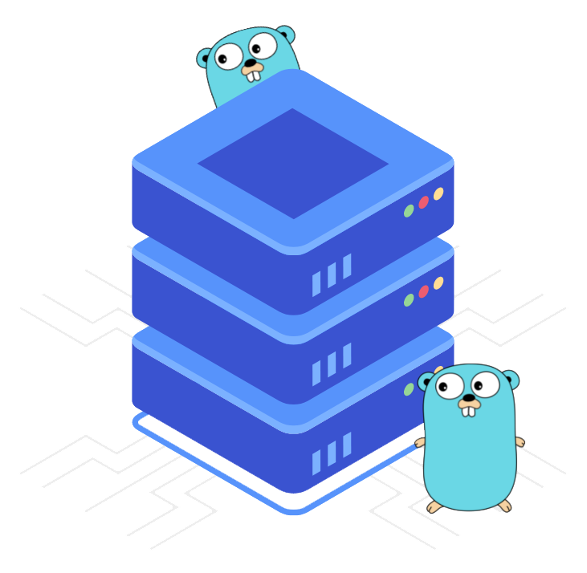
Programming with Golang

Slide 2
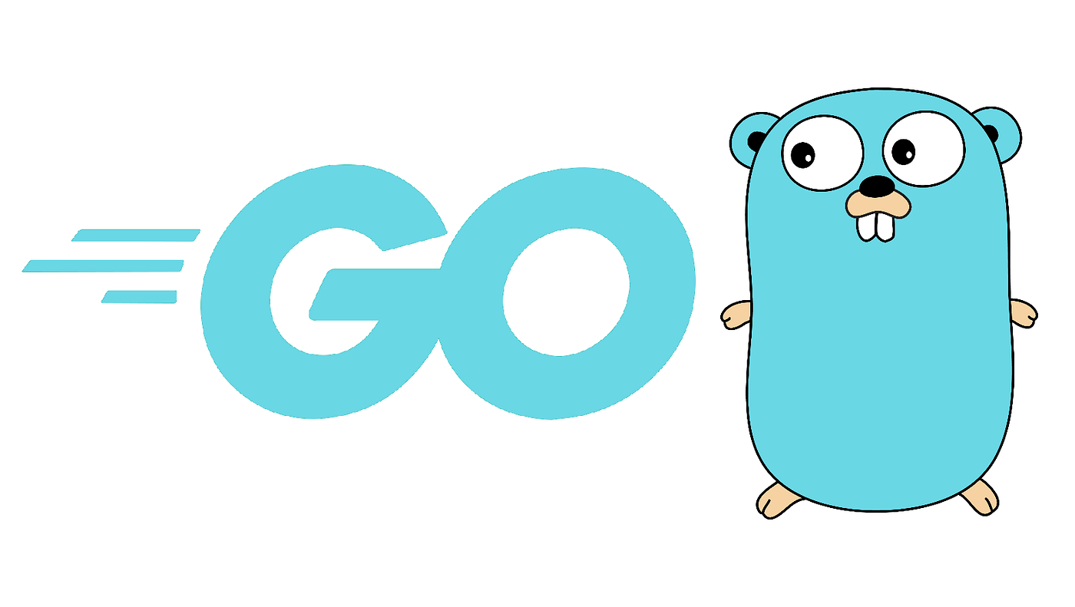
Course Introduction
Welcome to this introductory course on Programming with Golang. This is the first in a series of courses designed to prepare for Golang developer and back-end engineer which is aligned to make an individual highly capable in designing server-side and command line applications.

Slide 3





Course Introduction
This course is designed for beginners with no prior experience. The aim is to provide a strong foundation in the language and help newcomers become proficient in Go programming. You will learn:
How to develop programs in Golang
01
05
04
Unique error and panic handling using Golang
02
03
Fundamental concepts of Golang
Advanced concepts of Golang
Key aspects of Golang

Slide 4




Need for Programming with Golang
Efficiency and Performance
Strong Standard Library
Cross-Platform Support and
Garbage Collection
Simplicity, Scalability, and Readability
Notes:
Generative AI can create new and innovative types of images. This includes photorealistic images of fictional scenes, new artistic styles, and images that are more accessible to people with disabilities. MidJourney is particularly powerful at creating images with a wide range of styles.
Generative AI can democratize creative expression. Generative AI makes it possible for anyone to create high-quality images, even if they have no artistic training or experience. MidJourney is relatively easy to use, even for beginners.
Generative AI can solve real-world problems. Generative AI can be used to develop new medical imaging techniques, create synthetic training data for machine learning models, and generate realistic images for video games and movies. MidJourney is already being used by researchers and designers to solve real-world problems.
MidJourney is a powerful and versatile generative AI for image generation. It can be used to create a wide range of image types, from photorealistic images to abstract art. MidJourney is also relatively easy to use, making it a good choice for both beginners and experienced users.
MidJourney has the potential to revolutionize many different industries and applications. It can be used to create new and innovative forms of art, design, and entertainment. MidJourney can also be used to solve real-world problems in healthcare, science, and engineering.

Slide 5
Why Golang?
Go has a growing and active community
Wide range of community libraries
01
02
Language Maturity
03
Cloud-Native Development
04
Notes:
MidJourney is a new AI-powered image generation tool that has quickly gained popularity for its ability to create stunning and imaginative images from text prompts. It offers several advantages over other AI image generators, including:
High-quality images: MidJourney is known for producing well-structured, defined, and realistic images. Its images are often compared to the work of professional artists.
High image resolution: MidJourney can generate images with resolutions of up to 1,792 x 1,024 pixels, allowing for more space and detail in the images created.
Diverse artistic styles: MidJourney can generate images in a wide range of artistic styles, from classical realism to abstract expressionism. This makes it a versatile tool for artists and creative professionals alike.
Easy to use: MidJourney works through Discord, a widely used chat platform. Users can interact with the AI bot using simple commands, making it accessible even to those with no coding experience.
Active community: The MidJourney Discord server provides an active community where users can share their creations, ask questions, and receive help from both other users and the MidJourney team.

Slide 6





Course Objectives
Design and develop web application using Golang.
Perform unit and benchmark tests to ensure Go application code quality and performance.
Write effective code using advanced Golang features.
Work with a multitude of features well-suited for concurrent and systems programming.
Evaluate the possibility for creating sophisticated ERP systems, servers, complicated software, websites, and mobile backends.

Slide 7



Target Audience
This course is tailored for the following audience segment
Freshers
Web
Developers
Cloud
Engineers
Data Engineers and Scientists

Slide 8

Career Path for Golang
Career path for Go can be highly rewarding, as Go is a fast-growing programming language known for its efficiency and simplicity.
Junior Go Developer
Go Tech Lead
Go Architect
Notes:
Most of the images used in this course are generated by MidJourney

Slide 9

Dive into the world of Programming with Golang, a compiled language that produces fast and efficient code. It is designed to be lightweight and provides high-performance execution, making it suitable for a wide range of applications.
Best of Luck!

